Slide 1


Satyam Pathak 030747585
35th Conference on Neural Information Processing Systems (NeurIPS 2021)
Noisy Recurrent Neural Networks
Presented By

Slide 2

TABLE OF CONTENTS
1)Main Objectives
2)Introduction Of the Research Paper
3)Model Explanation
4)Key Contributions
5)Methodology
6)Experimental Results
7)Conclusion
8)Future Scope

Slide 3
Main Objectives
A framework for studying recurrent neural networks (RNNs) trained by injecting noise into hidden states
RNNs that can be viewed as discretizations of stochastic differential equations driven by input data
This framework allows us to study the implicit regularization effect of general noise injection schemes by deriving an approximate explicit regularizer in the small noise regime

Slide 4
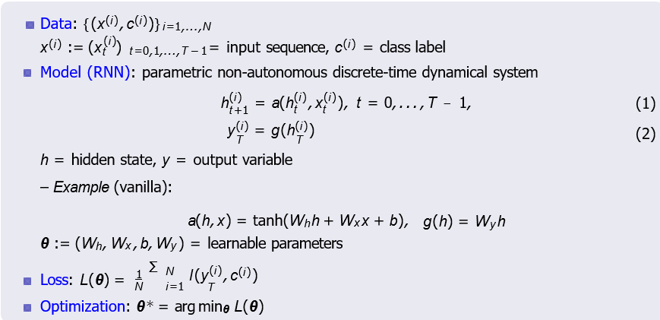
Introduction Of Research Paper

Slide 5
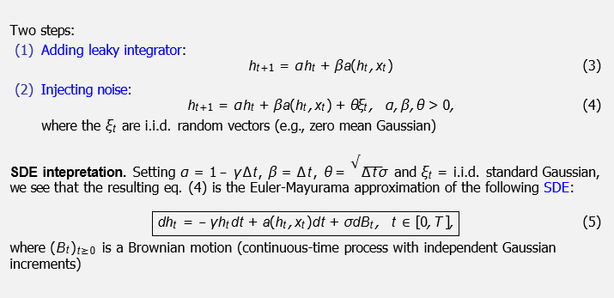
NRNN (Framework)

Slide 6
Intro Noisy RNNs Main Results
Noisy Recurrent Neural Networks (NRNNs)
Main Results (Experiments)
Conclusion
More generally, the paper consider the following (Itˆo) SDE model for RNN. Let x ∈ C ([0, T ], R^{dx} ) be an input signal.
Continuous-Time NRNNs
dht = f (ht, xt )dt + σ(ht, xt )dBt, yt = Vht,
where σ : R^{dh} × R^{dx} → R^{dh ×r} and (Bt )_{t≥0} is an r -dimensional Brownian motion.
(6)
The functions f and σ are referred to as the drift and diffusion coefficients, respectively.
Intuitively, (6) amounts to a noisy perturbation of the corresponding deterministic CT-RNN To guarantee the existence of a unique solution to (6), in the sequel, we assume that
{f (·, xt )}_{t∈[0,T ]} and {σ(·, xt )}_{t∈[0,T ]} are uniformly Lipschitz continuous, and t ›→ f (h, xt ),
t ›→ σ(h, xt ) are bounded in t ∈ [0, T ] for each fixed h ∈ R^{dh}

Slide 7
Intro Noisy RNNs Main Results
Choice of Drift and Diffusion Coefficient
Main Results (Experiments)
Conclusion
f (h, x ) = Ah + a(Wh + Ux + b),
(7)
where a : R → R is a Lipschitz continuous scalar activation function extended to act on vectors pointwise, A, W ∈ R^{dh ×dh} , U ∈ R^{dh ×dx} and b ∈ R^{dh}
Drift = a linear component + a Lipschitz nonlinearity
σ(h, x ) = є(σ1I + σ2diag(f (h, x ))), where є > 0 is small, and σ1 ≥ 0 and σ2 ≥ 0 are tunable parameters
(8)
Diffusion = additive + a multiplicative noise
One can set є = 0 at inference time
=⇒ noise injections in NRNNs can be viewed as a stochastic learning strategy

Slide 8
Intro Noisy RNNs Main Results Main Results (Experiments)
From Continuous-Time to Discrete-Time NRNNs
Conclusion
We consider explicit Euler-Maruyama (E-M) integrators, which are the stochastic analogues of Euler-type integration schemes for ODEs.
Let 0 = t0 < t1 < · · · < t_{M} = T be a partition of the interval [0, T ]. Denote
δm := tm+1 − tm for each m = 0, 1, . . . , M − 1, and δ := (δm )
The E-M scheme provides a family (parametrized by δ) of approximations to the solution of the SDE in (6):
Discrete-Time NRNNs
_{h}δ
√
δ
δ
δ
= h + f (h , xˆ )δ + σ(h , xˆ ) δ ξ , (9)
m+1 m m m m m m m m
for m = 0, 1, . . . , M − 1, where (xˆm )_{m=0,...,M−1} is a given sequential data, the ξm ∼ N(0, I )
are independent r -dimensional standard normal random vectors, and h^{δ} = h0
0

Slide 9
Key Contributions
To examine discretization strategies of stochastic differential equations simulating the injection of noise into networks' hidden states, some important technical findings are presented.
hese findings support the injection scheme's regularization impact. This is a significant finding that is supported by several illustrative simulations
The study's findings demonstrate how noise injection might further increase the RNN dynamics' temporal stability. The use of noise injection for recurrent neural networks is motivated by these, and experiments are offered to support the theoretical findings.

Slide 10
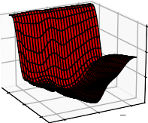
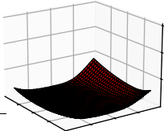
Main Results (Theory)
We study Noisy RNNs via the lens of implicit regularization and derive an explicit regularizer induced by the noise injection through a perturbation analysis in the small noise regime
It turns out that this regularizer reduces the state-to-state Jacobians and Hessian of the loss function according to the noise level, thereby promoting flatter minima and biasing towards models with more stable dynamics
 | 300 | 300
 | 200 | 200
0.02 0.00 | 100 0.02 _{0.00} 0.02 0.00 | 100 _{0.00}0.02 0.02
0.02 _{0.02}
0.02
Figure: Hessian loss landscapes for deterministic (left) and noisy (right) model
We show that, in this small noise regime, NRNNs promote classifiers with large classification margin, an attribute linked to improved model robustness
We also provide sufficient conditions for stability of the SDE, showing that noise injection can improve stability during training

Slide 11
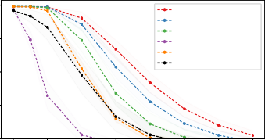
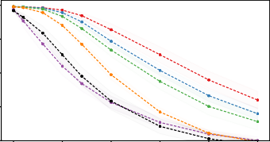
Main Results (Experiments)
We demonstrate on benchmark data sets that NRNN classifiers are more robust to data perturbations when compared to other recurrent models, while retaining SOTA performance for clean data
Table: Robustness w.r.t. white noise (σ) and S&P (α) perturbations on the ordered MNIST task.
Name | clean | σ = 0.1 | σ = 0.2 | σ = 0.3 | α = 0.03 | α = 0.05 | α = 0.1
Antisymmetric RNN (Chang et. al., 2019) | 97.5% | 45.7% | 22.3% | 17.0% | 77.1% | 63.9% | 42.6%
CoRNN (Rusch et. al., 2021) | 99.1% | 96.6% | 61.9% | 32.1% | 95.6% | 88.1% | 58.9%
Exponential RNN (Lezcano et. al., 2019) | 96.7% | 86.7% | 58.1% | 33.3% | 83.6% | 70.7% | 43.4%
Lipschitz RNN (Erichson et. al., 2020) | 99.2% | 98.4% | 78.9% | 47.1% | 97.6% | 93.4% | 73.5%
NRNN (mult. noise: 0.02 / add. noise: 0.02) | 99.1% | 98.9% | 88.4% | 62.9% | 98.3% | 95.6% | 78.7%
NRNN (mult. noise: 0.02 / add. noise: 0.05) | 99.1% | 98.9% | 92.2% | 73.5% | 98.5% | 97.1% | 85.5%
1.0 | Noisy RNN (0.02/0.05) | 1.0
 | Noisy RNN (0.02/0.02)
0.8 | Lipschitz RNN Antisymmetric RNN | 0.8
 | coRNN
 | expRNN
0.6 |  | 0.6
test accuracy
0.4
0.4
0.2
0.0 0.1 0.2 0.3 0.4 0.5 0.6
amount of noise
(a) White noise perturbations.
0.7
0.2
amount of noise
(b) Salt and pepper perturbations.
0.00
0.05 0.10 0.15 0.20
0.25
Figure: Test accuracy for the ordered MNIST task as a function of the strength of input perturbations.

Slide 12
Conclusion
Noise injection can be viewed as a stochastic learning strategy used to improve robustness of learning models against data perturbations
Within the framework of SDEs, we study RNNs trained by injecting noise into the hidden states and the implicit regularization effects of general noise injection schemes, showing that noise injection promotes classifiers with large classification margin
Our empirical results are in agreement with our theory and its implications, finding that NRNN classifiers achieve superior robustness to input perturbations

Slide 13
Future Scope
The ultimate objective of these evaluations might be to enhance the performance of NRNNs. On the other hand, although it is demonstrated here that the noise implicitly stabilizes RNNs , it may have a deleterious effect on the capacity for long-term memory
Future work will include studies to take into consideration both of these things as well as the implicit bias brought on by the stochastic optimization process

